Slide 1
Human variation
Human variation and evolution

Slide 2
Human variation: defined
Human variation refers to the fact that there are a range of possible values for each of the numerous physical characteristics of human beings.
People of the same species can have differing phenotypic traits that can be related to:
  Sex
  Ancestry
  Environment

Slide 3
Race vs ancestry
Race is not a biological concept, but rather a social construct
“race” is a construct created to stereotype peoples of different geological ancestry
Although there are no genetic differences between humans of different ancestries, there are some phenotypic and morphological differences between them
The three main anthropological ancestries are African, Asian, and European

Slide 4
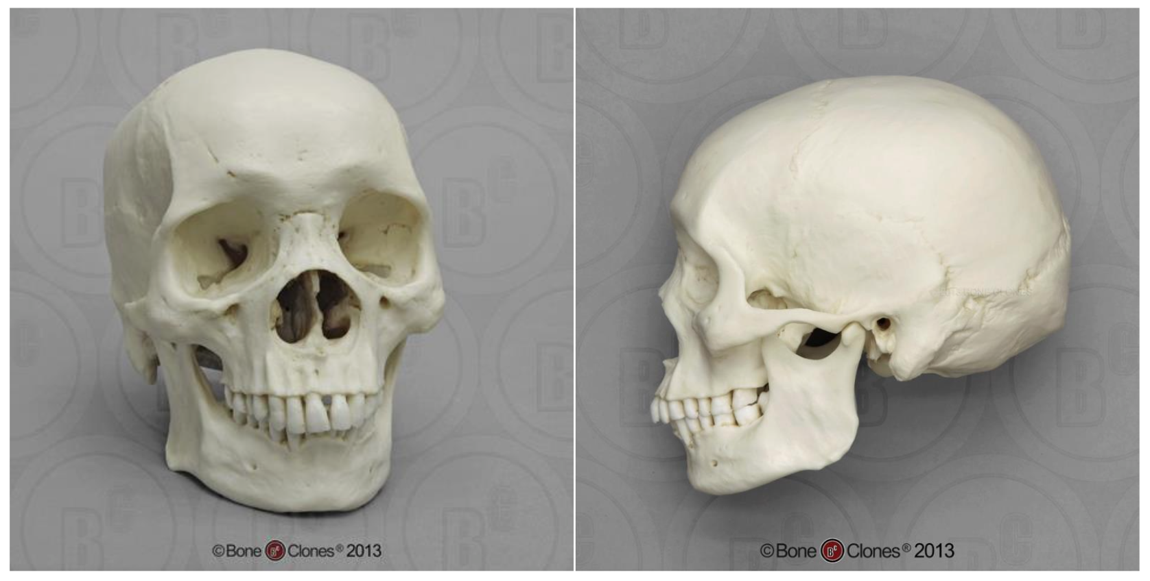
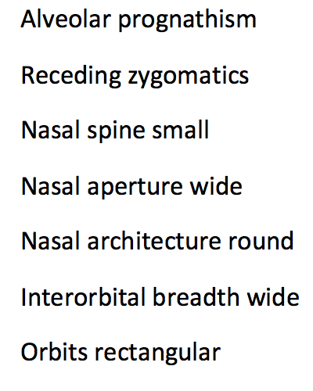
Cranial variations: African

Slide 5
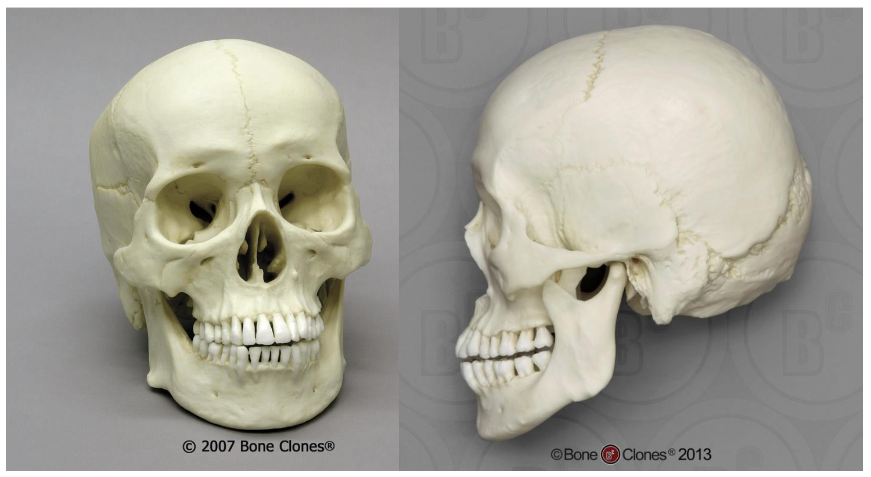
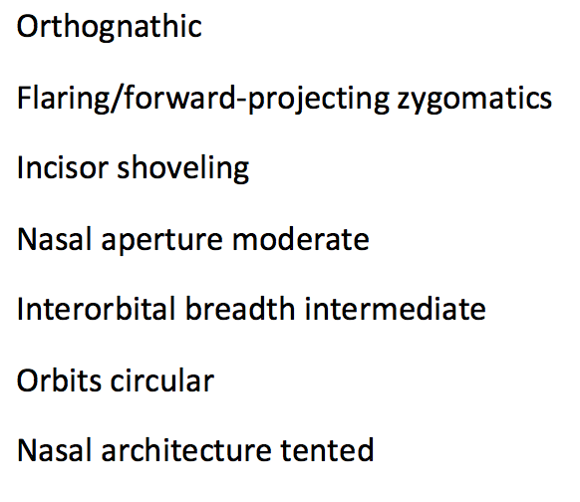
Cranial variation: Asian

Slide 6
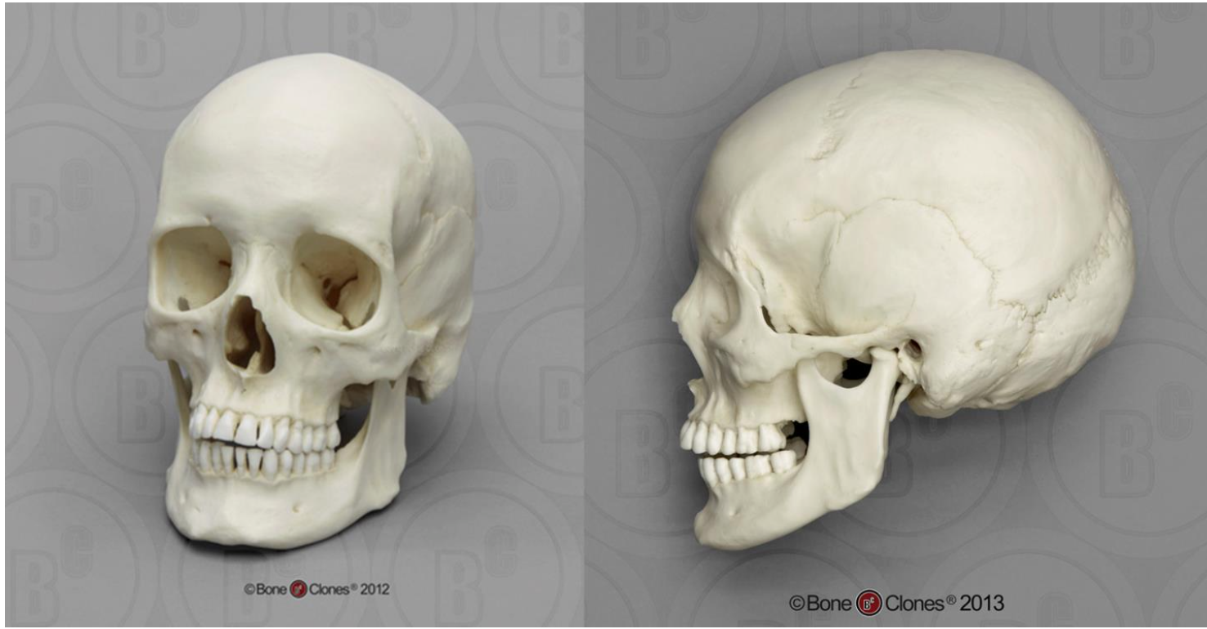
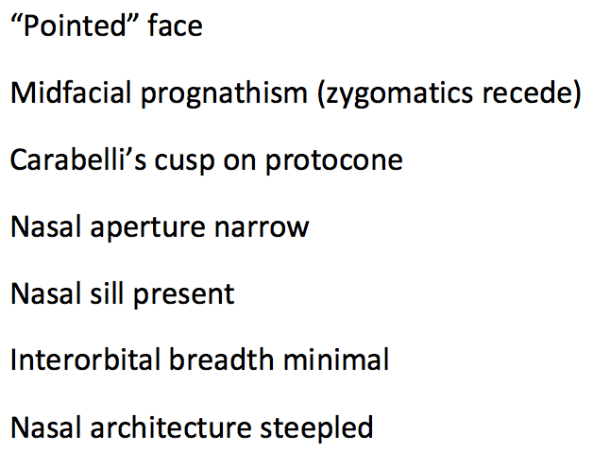
Cranial variation: European

Slide 7
What might cause these differences?

Slide 8
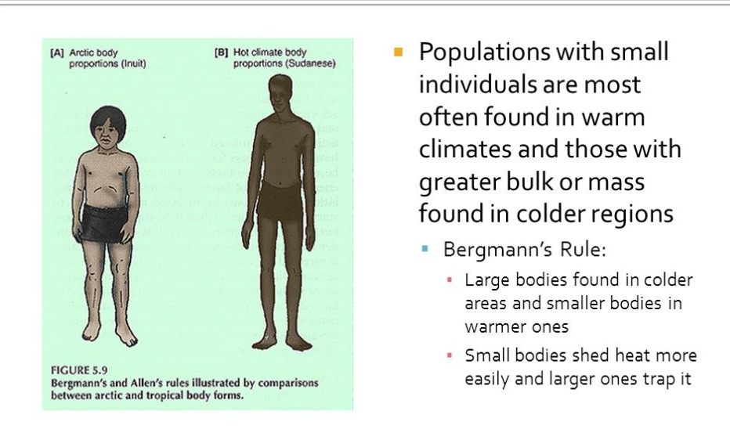
Adaptation
  To say that an organism is adapted to its environment involves a genetic trait. Those individuals that possess genetic traits that allow them to survive and reproduce better than their peers are better adapted to their environment.
  Ex: body build in different climates
    Allen’s Rule-limb length
    Bergmann’s Rules- body size

Slide 9
acclimatization
  physical environments can also introduce changes in a population without resorting to genetic change. We call this process acclimatization. Acclimatization involves physiological adjustments by an individual to certain environmental conditions. Individuals develop these during their lifetimes. They are not born with them, although over time, a population may become adapted to a certain environment due to them.
Ex: shivering when it is cold

Slide 10
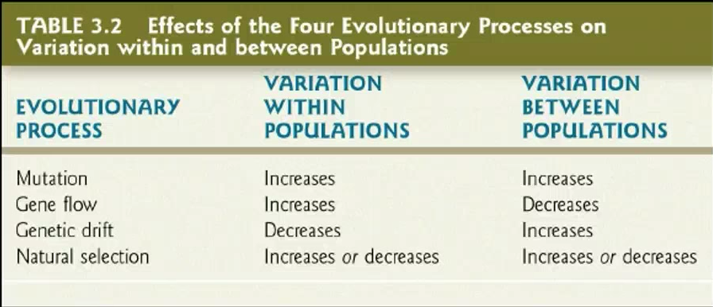
4 Evolutionary processes
    Natural Selection- genetic mutation leads to variant individuals in each generation and those best suited produce more offspring
    Mutation-creation of a new allele for a gene when the portion of the DNA molecule to which it corresponds in suddenly altered
    Gene Flow
    Genetic Drift

Slide 11
Sex
  Some species, like gorillas, have high sexual dimorphism; while Homo sapiens have a level of sexual dimorphism, it is subtler, with slight differences in cranial and post-cranial skeletal morphology.

Slide 12
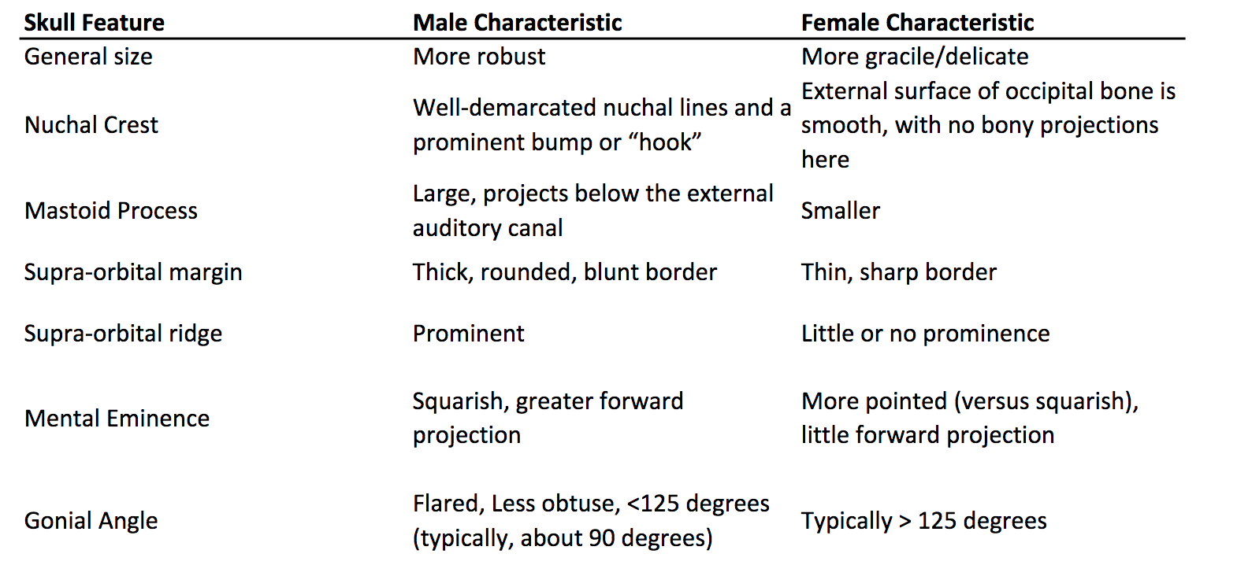
Cranial variation

Slide 13
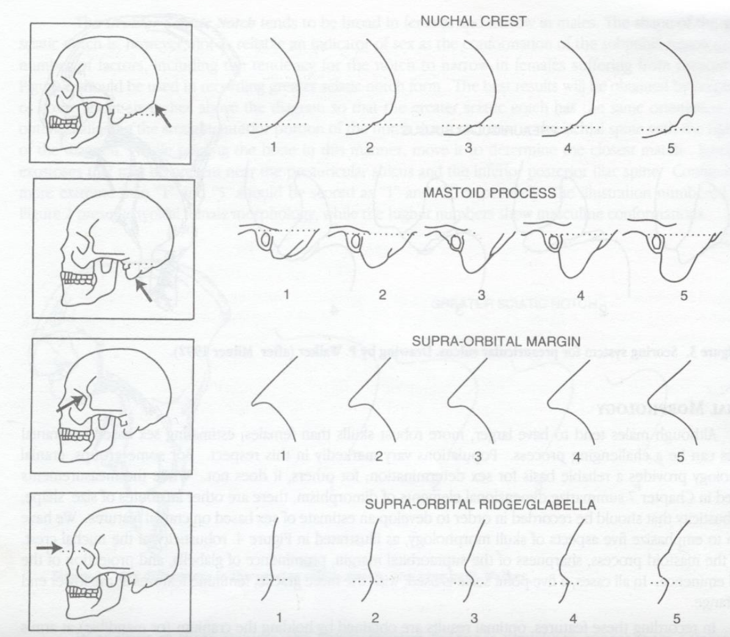
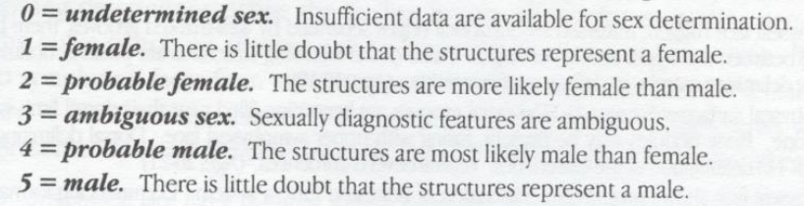
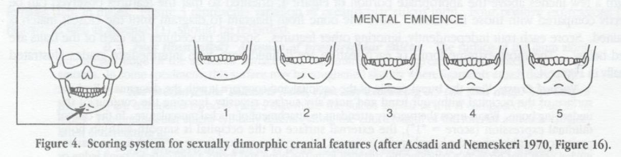
Cranial variation

Slide 14
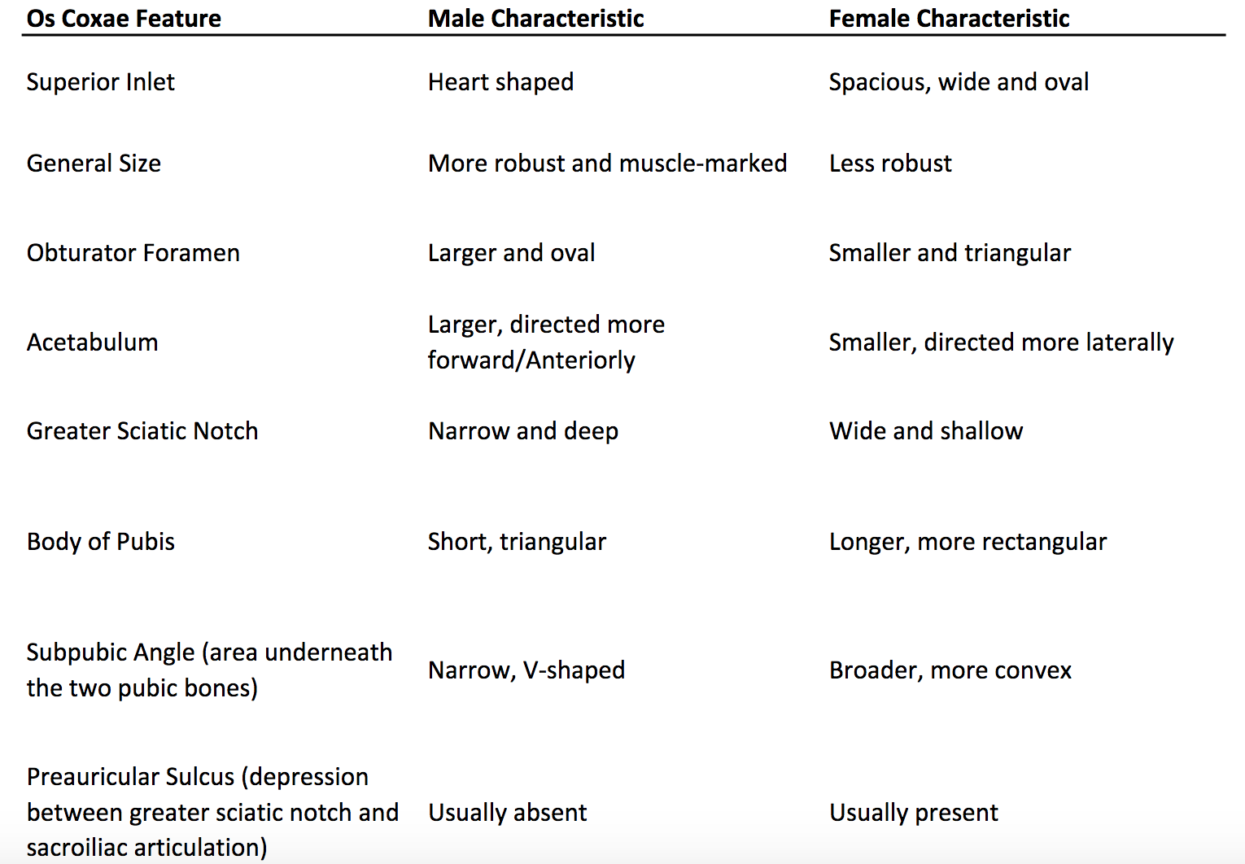
Postcranial variation

Slide 15
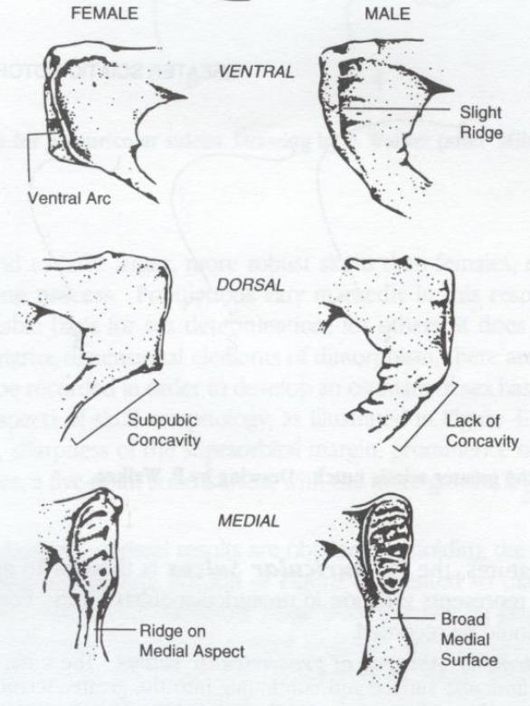
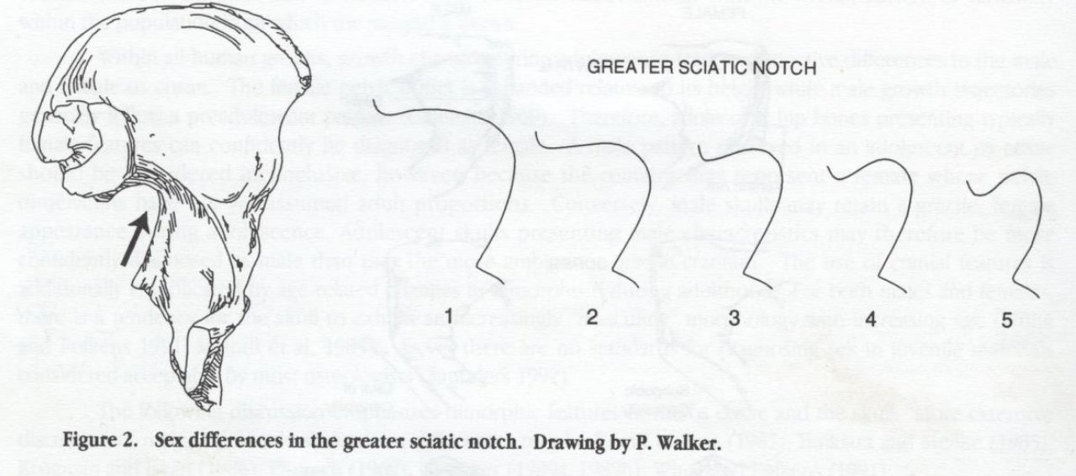
Postcranial variation

Slide 16
Bias in the Fossil record
Not all bones become fossils so it can create a bias when deciding if a new find is a new species or just a member of an already defined species with a morphological difference
Many times in the study of paleoanthropology only a few bones or crania are found from any one species so there is not sufficient data to create catalogue of all the variations that may be present within any said species

Slide 17
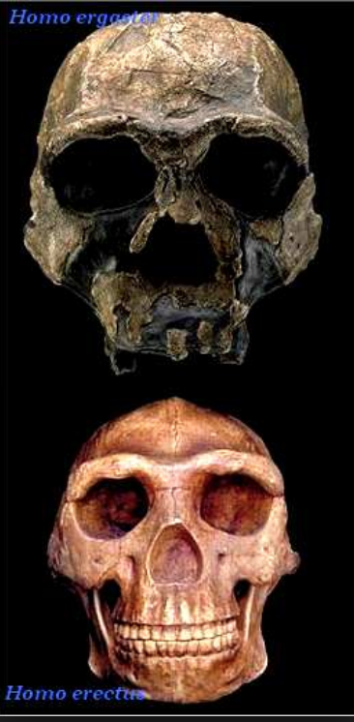
Case study: erectus vs ergaster
Many paleoanthropologists thing that H. erectus and H. ergaster actually belong to the same species. H. ergaster is used for the African variant of H. erectus, whereas plain H. erectus refers to the European populations.
Alternatively, H. ergaster could be the direct ancestor of H. erectus. There is obviously variation in bone structure between the two geographical regions, but as with modern humans, phenotypic variation can dramatically over exaggerate any real genetic difference in a population. As we have explored, H. sapiens can have different skeletal morphology depending on geological ancestry. This may be the case with H. erectus as well; erectus and ergaster might very well be the same species, just with differing phenotypic expression due to environmental differences

Slide 18
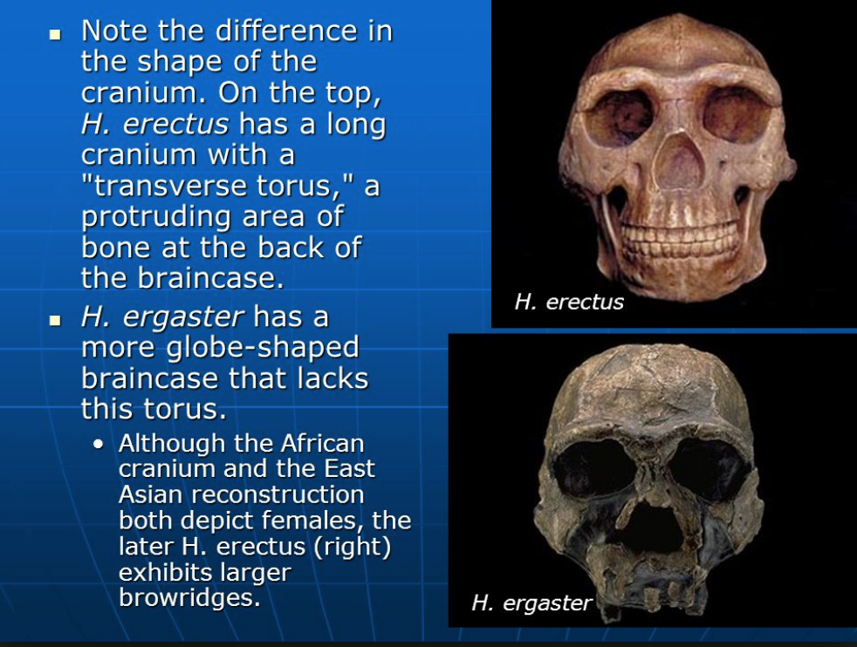
Case study: erectus vs ergaster

